Slide 1
Manufacturing Technology
01/02/2018 (ME461)
Instructor: Shantanu Bhattacharya

Slide 2
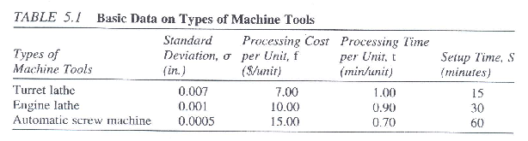
Numerical Problem
Suppose 500 units of a shaft are to be manufactured within 1+ 0.003 in. Suppose there are three alternative machine tools with the information given in Table below. Use the models developed earlier to perform the turning operation.
The other data are:
Unit raw material cost = $10.00
Unit salvage value = $2.00
Process average= 1.0015in.

Slide 3
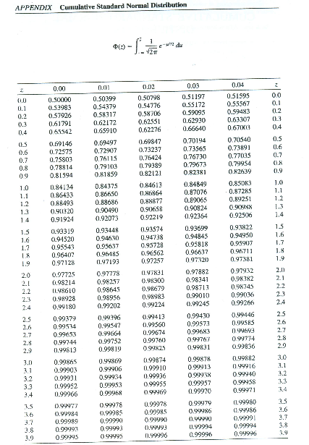
Normal Distribution Charts

Slide 4
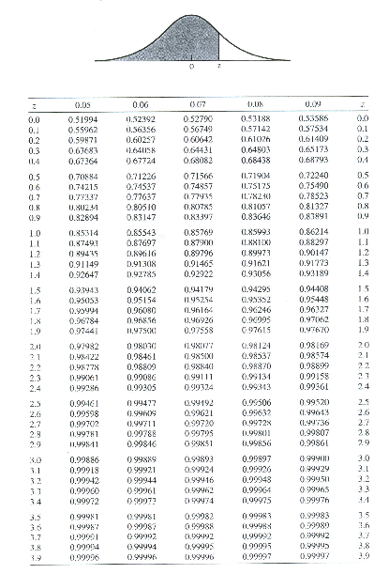
Normal Distribution Chart

Slide 5
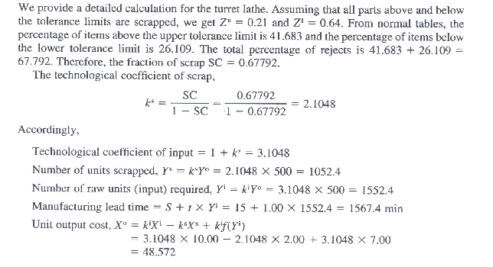
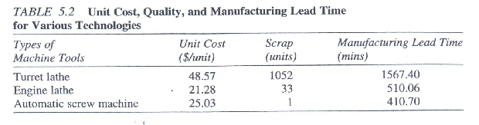
Solution

Slide 6
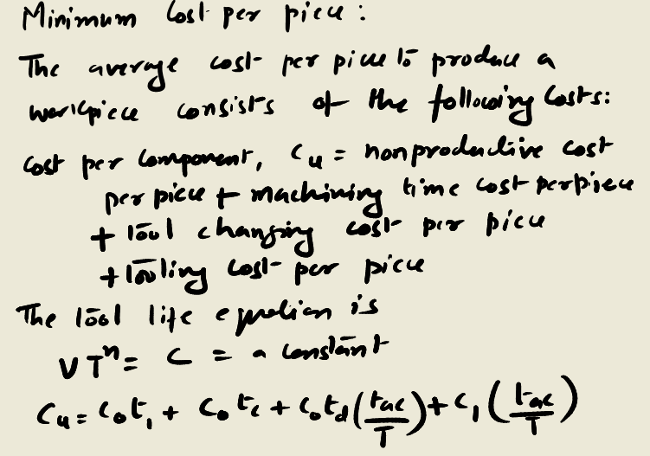
Determining Machining Conditions and Manufacturing times
Having specified the work-piece material, machine tool, and cutting tool, the question is what can be controlled to reduce the cost and increase production rate.
The controllable variables are cutting speed (v), feed (f), and depth of cut (d). Jointly, v,f, and d are referred to as machining conditions. There are a no. of models specifying optimal machining conditions out of which the two best ones are:
Co= cost rate including labor and overhead cost rates ($/min.)
C1= tool cost per cutting edge, which depends on type of tool used
C= constant in tool life equation
V= cutting speed in meters/min.
f=Feed rate (mm/rev)
d=depth of cut(mm)
n= exponent in the tool life equat.
t1=non productive time consisting of loading and unloading the part (min.)
tc= machining time per piece (min/piece)
T= tool life (min.)
td= time to change a cutting edge (min.)
tac= actual cutting time per piece, which is approximately equal to tc (min/piece)

Slide 7
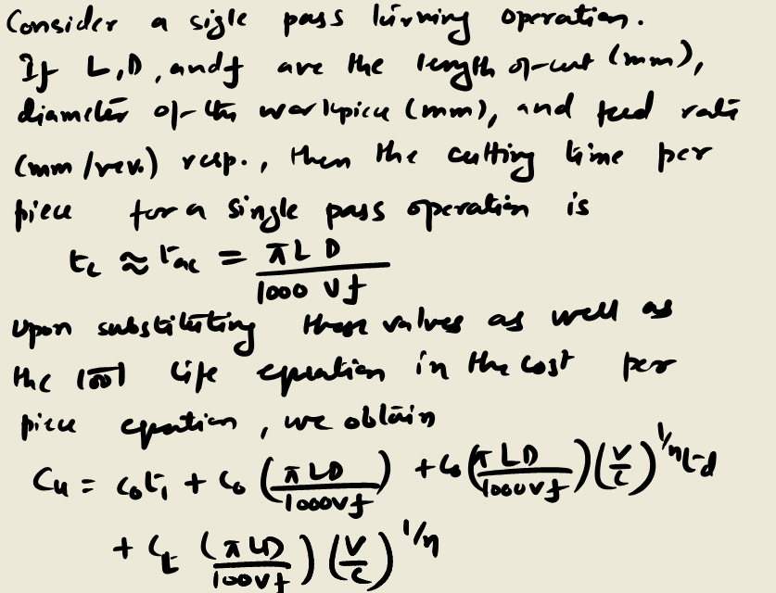
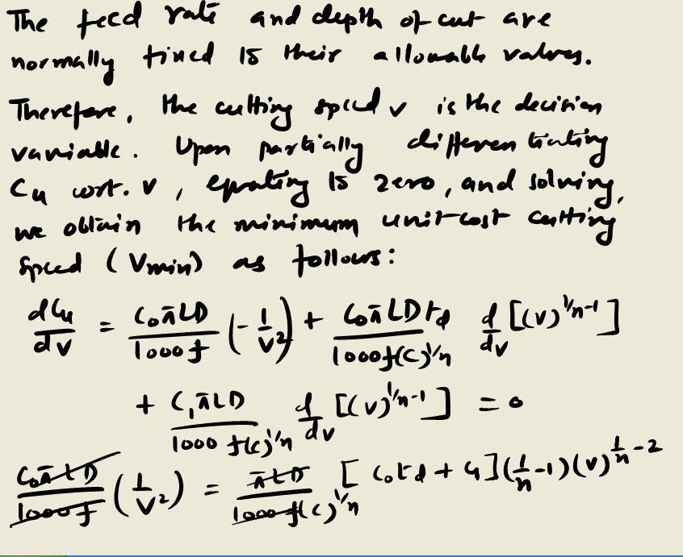
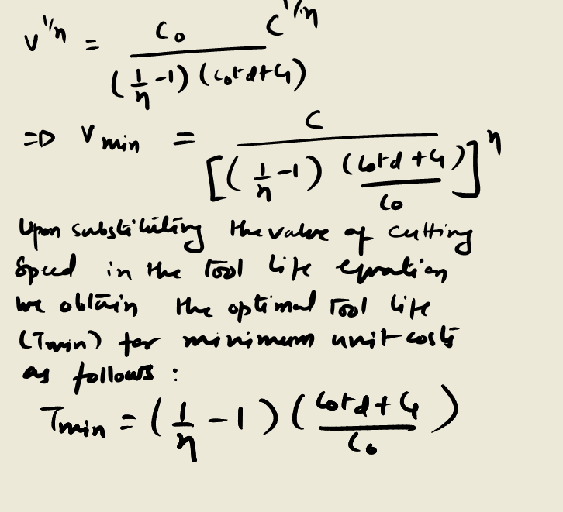
Determining Machining Conditions and Manufacturing times

